Slide 1
Signal Representation
Ajit S. Bopardikar
Project Manager
Conexant Systems India Pvt. Ltd.
Hyderabad

Slide 2
Overview
What is a signal?
Continuous-time signal
Discrete-time signal

Slide 3
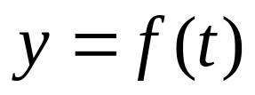
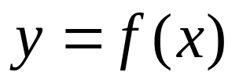
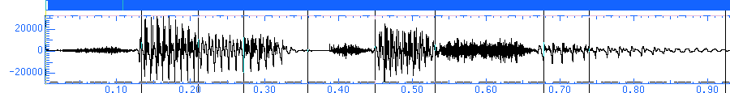
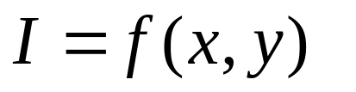
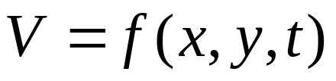
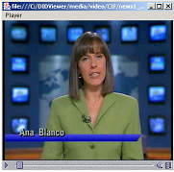

Recapitulation: What is a signal?
Functions of one or more independent variables.
Information is contained in a pattern of variation.

Slide 4
Continuous-Time Signal
Function of a continuous variable
Can take a range of continuous values
Also called analog signal
Example: Natural Signals such as speech, audio, etc.

Slide 5
Continuous-Time Signal Processing
Also referred to as Analog Signal Processing
Concerned with methodologies to analyze, enhance, represent, modify or extract information from a continuous-time signal

Slide 6
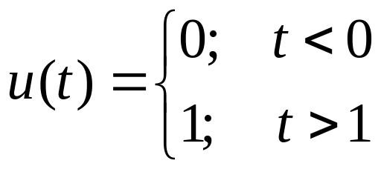


Basic Continuous-Time Signals: Unit Step
0

Slide 7



Basic Continuous-Time Signals: The Impulse Function
Also known as the Dirac Delta function
Obtained by differentiating a unit step function
Defining Characteristic
0

Slide 8
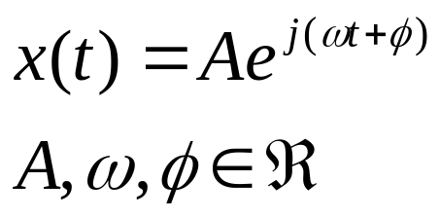

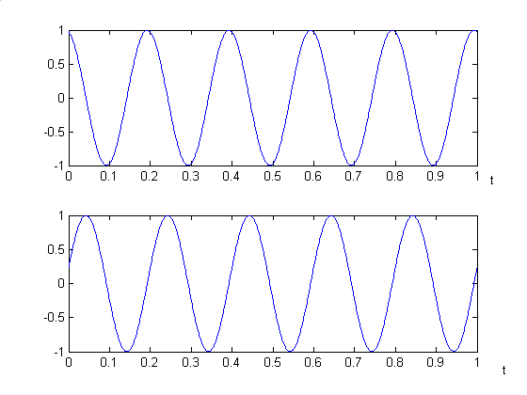
Basic Continuous-Time Signals: The Complex Exponential

Slide 9
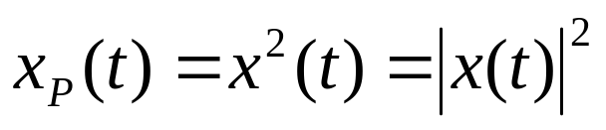
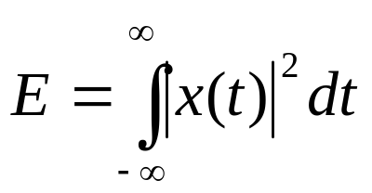
Signal Power and Energy
Power
Energy

Slide 10
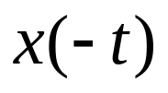



Some Basic Signal Transformations: Reflection
Reflection

Slide 11
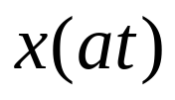

Some Basic Signal Transformations: Scaling/Dilations
Scaling/Dilation
-1
0
1
-2
-1
0
1
2

Slide 12
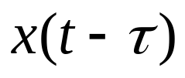


Some Basic Signal Transformations: Translation
Translation
0
0

Slide 13
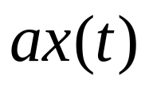

Some Basic Signal Transformations: Amplitude Scaling
Amplitude Scaling/Scalar multiplication
0
0

Slide 14
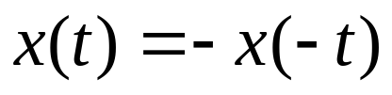
Definitions: Odd Signal
Odd Signal:
0

Slide 15
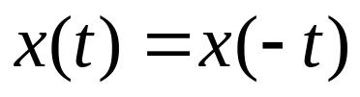
Definition: Even Signal
Even Signal:
0

Slide 16
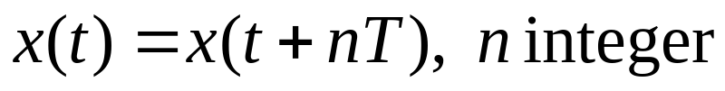


Definition: Periodic Signal
Periodic Signal:
0

Slide 17
Discrete-Time Signals
Defined only at discrete-time
Independent variable takes on only a discrete set of values

Slide 18
Discrete-Time Signal Processing
Concerned with methodologies to analyze, enhance, represent, modify or otherwise extract information from a discrete-time signal

Slide 19
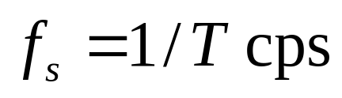
Discrete-Time Signal from Continuous-Time Signal: Sampling
Discrete-time signals are often obtained by sampling continuous-time signals.
Suppose samples taken T seconds apart.
Then sampling frequency is
Question: What should the sampling frequency be?

Slide 20
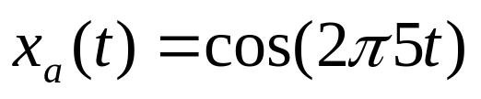
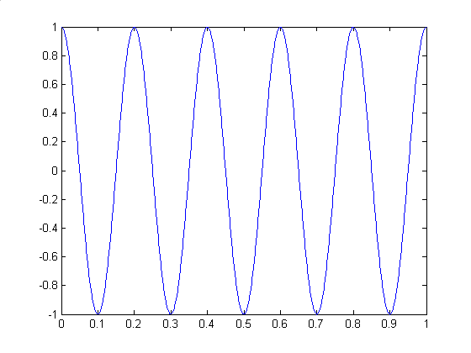
Discrete-Time Signal From Continuous Time Signal: Sampling

Slide 21


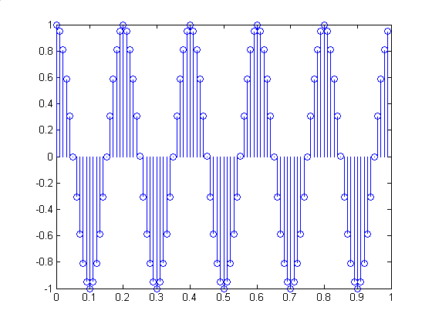
Discrete-Time Signal From Continuous Time Signal: Sampling

Slide 22

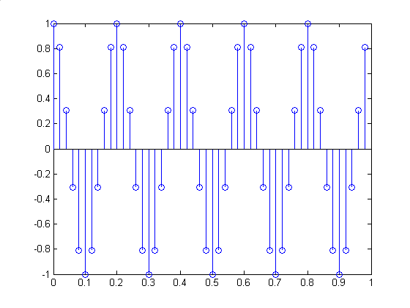
Discrete-Time Signal From Continuous Time Signal: Sampling

Slide 23

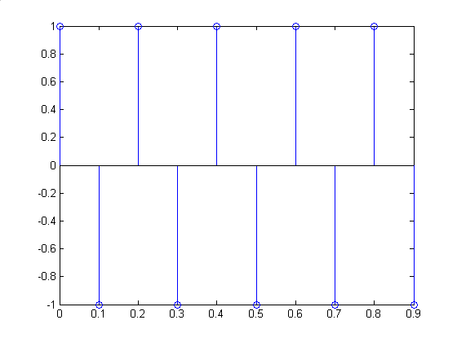
Discrete-Time Signal From Continuous Time Signal: Sampling

Slide 24

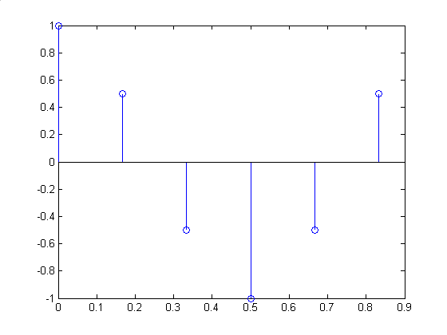
Discrete-Time Signal From Continuous Time Signal: Sampling

Slide 25

Sampling Theorem: First Cut
Critical sampling frequency is twice the frequency of the sinusoid
Once sampling rate is fixed it is typically normalized to 1 for processing the discrete-time signal.

Slide 26
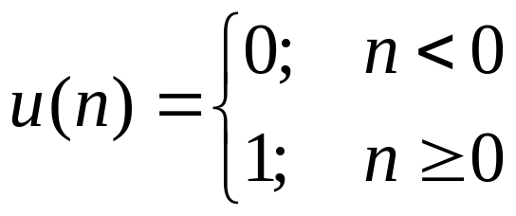
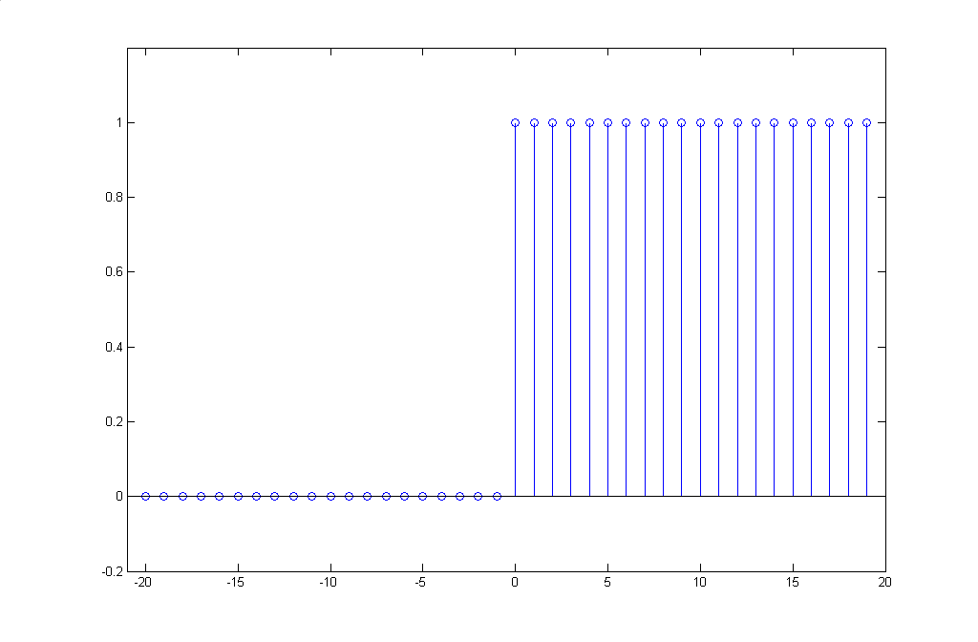
Example: Unit Step

Slide 27
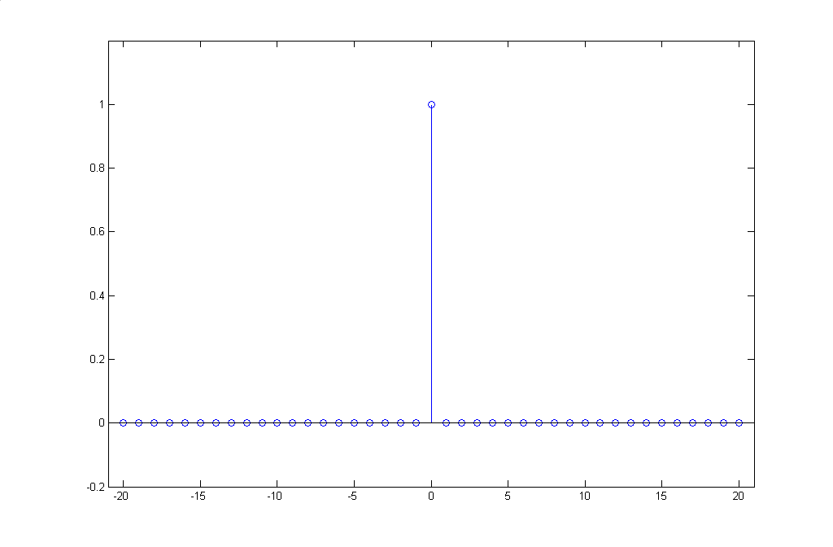
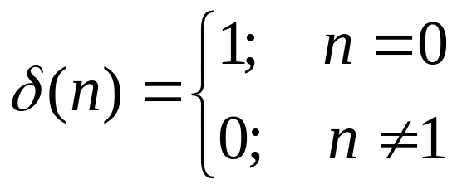
Example: The Impulse Function

Slide 28
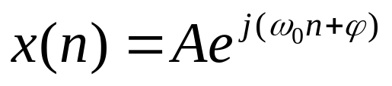
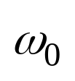
Examples: Complex Exponential
General form
is the frequency of the complex exponential in radians or radians/sample

Slide 29
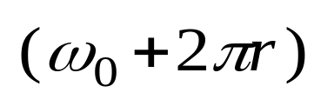
Complex Exponential: Properties
Complex exponential sequences with frequencies are indistinguishable from each other
Only frequencies in the range, 0 to 2π are unique.
Notes:
Verify this property in assignment?

Slide 30
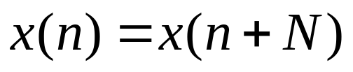
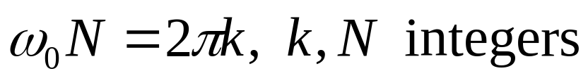
Definitions: Periodic Signals
For the complex exponential/sinusoidal signals this means only signals where the following holds are periodic

Slide 31
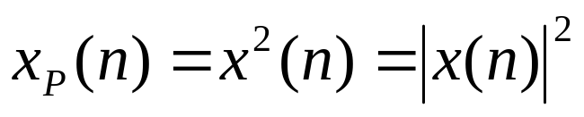
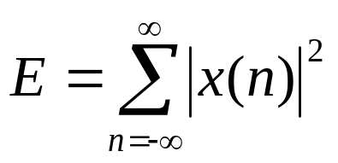
Signal Power and Energy
Power
Energy

Slide 32
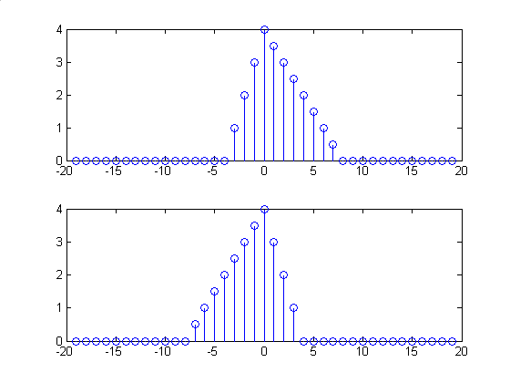


Basic Signal Transformations: Reflection

Slide 33
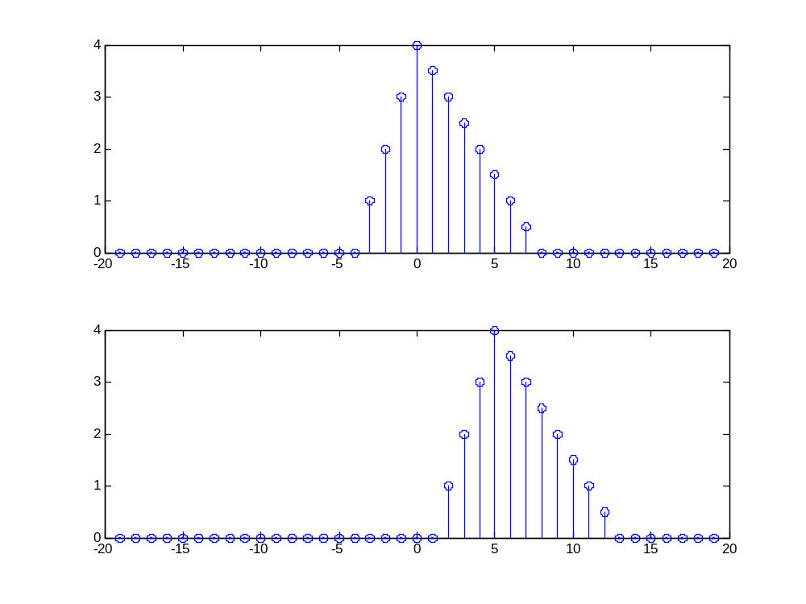

Basic Signal Transformation: Translation

Slide 34
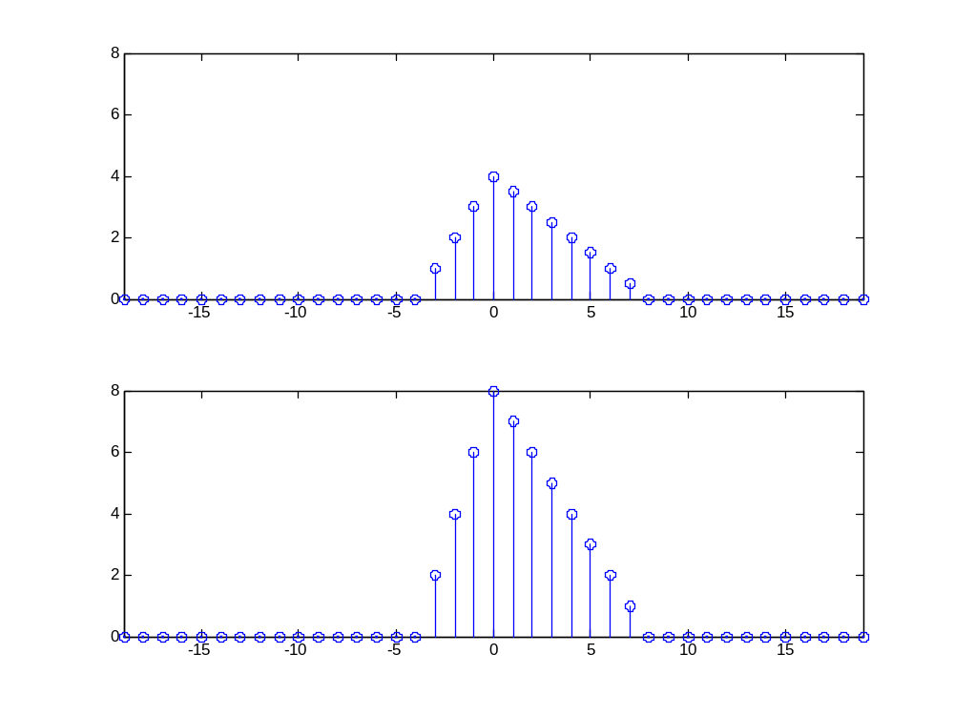

Basic Signal Transformation: Amplitude Scaling

Slide 35
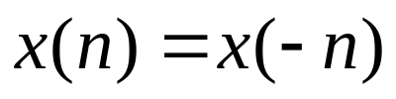
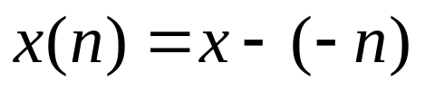
Definitions: Even and Odd Signals
Even Signal/Sequence
Odd Signal/Sequence

Slide 36
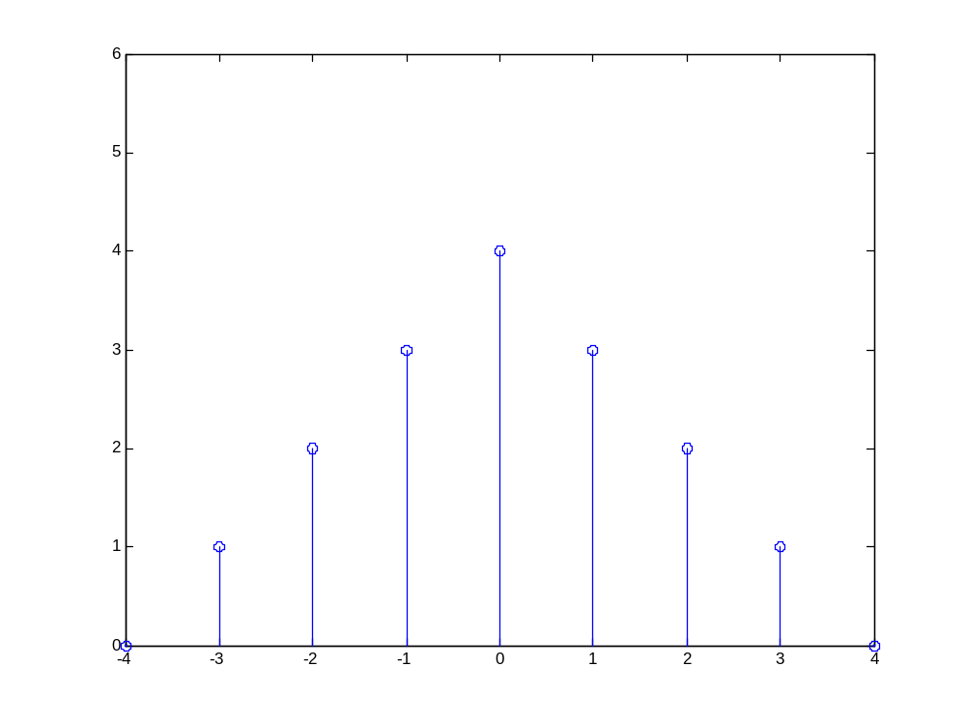
Whole Sample Symmetry

Slide 37
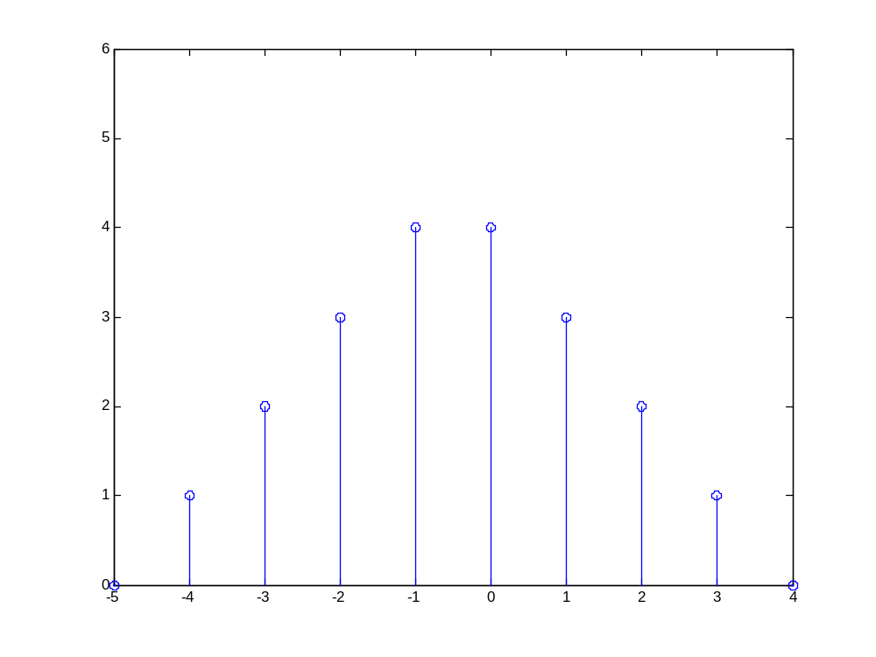
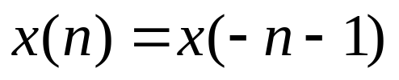
Half Sample Symmetry

Slide 38
Reading List
Oppenheim, A. V., Willsky, A. S., Young, I. T., “Signal and Systems,” Prentice-Hall, India, New Delhi, 1992.
Lyons, R. G., “Understanding Digital Signal Processing,” Addision-Wesley, 1997.
Oppenheim, A. V., Schafer, R. W., “Discrete-time Signal Processing,” Prentice-Hall, India, 1989.

